Slide 1
Chapter 5:
Process Scheduling

Slide 2
Chapter 5: CPU Scheduling
5.1 Basic Concepts
5.2 Scheduling Criteria
5.3 Scheduling Algorithms
OBJECTIVES
To introduce CPU scheduling, which is the basis for multiprogrammed operating systems
To describe various CPU-scheduling algorithms

Slide 3
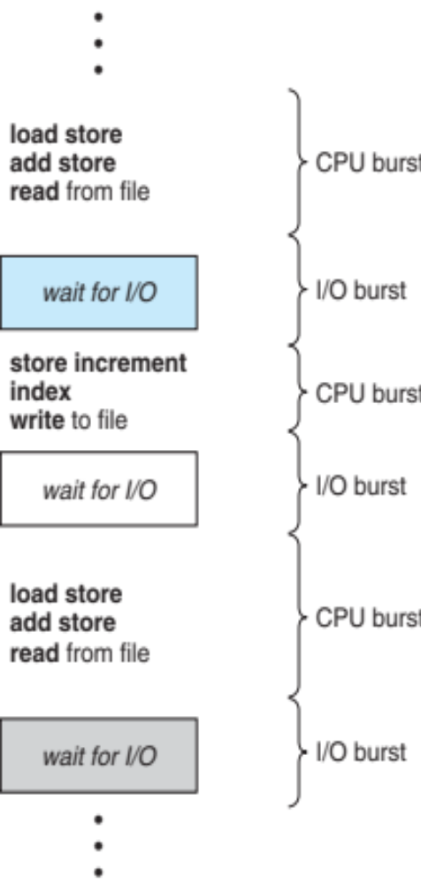
5.1 Basic Concepts
Maximum CPU utilization obtained with multiprogramming
Most processes exhibit the following behavior:
CPU burst followed by I/O burst
CPU–I/O Burst Cycle – Process execution consists of a cycle of CPU execution and I/O wait
CPU burst distribution is of main concern
Figure 5.1 Alternating sequence of CPU and I/O bursts

Slide 4
CPU-I/O Burst Cycle
{
printf(“Enter first integer: “);
scanf(“%d”, &b);
y = b+(b*b)+1;
printf(“\n b+(b*b)+1 = %d”, y);
}
________
________
________
I/O cycle
CPU burst
I/O cycle
Figure: Example part of C language programming

Slide 5
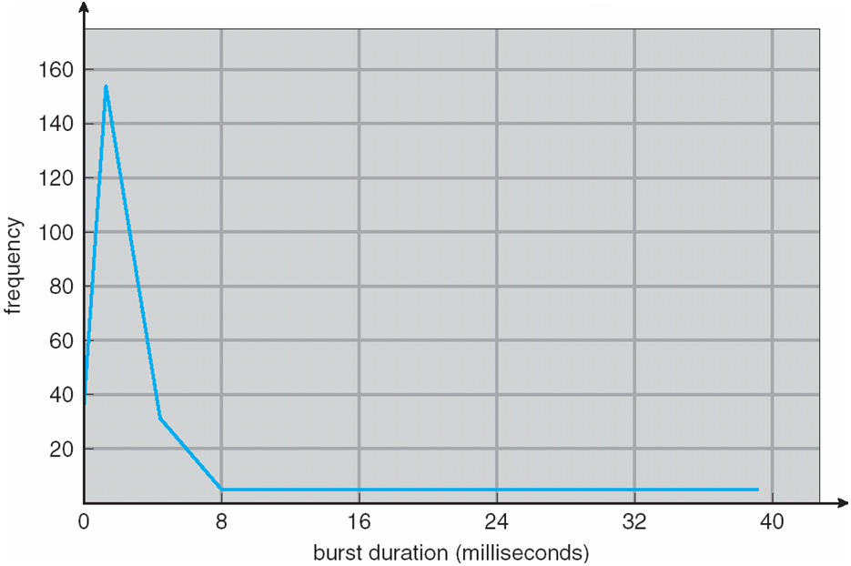
Histogram of CPU-burst Times
Figure 5.2

Slide 6
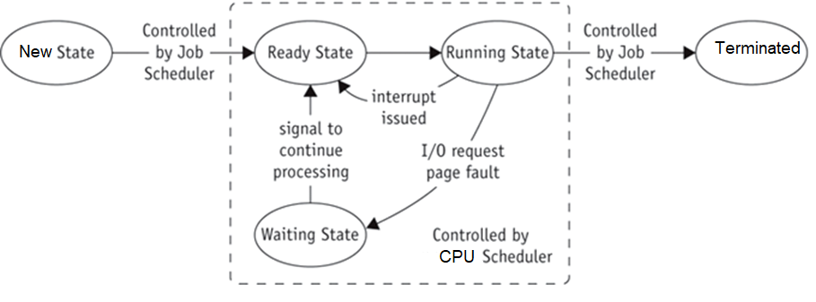
Job and Process Status
Jobs move through the system.
Job scheduler (long-term) vs CPU scheduler (short-term)

Slide 7
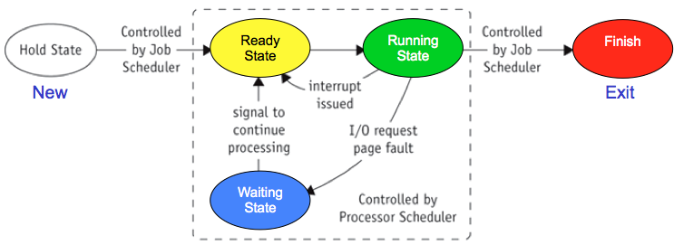
User submits job
(batch/interactive)
  Job accepted
    Put on HOLD and placed in queue
  Job state changes from NEW to READY
    Indicates job waiting for CPU
  Job state changes from READY to RUNNING
    When selected for CPU and processing
  Job state changes from RUNNING to WAITING
    Requires unavailable resources
  Job state changes to TERMINATED
    Job completed (successfully or unsuccessfully)

Slide 8
PCBs and Queuing
Job PCB
  Created when Job Scheduler (JS) accepts job
  Updated as job executes
  Queues use PCBs to track jobs
  Contains all necessary job management processing data
  PCBs linked to form queues (jobs not linked)
  Manage queues using:
    Process scheduling policies and
    Process algorithms
(Continued Next)

Slide 9
CPU Scheduler
Whenever the CPU becomes idle, the operating system must select one of the processes in the ready queue to be executed.
The selection process is carried out by the CPU scheduler.
The ready queue may be ordered in various ways.
CPU scheduling decisions may take place when a process:
  1. Switches from running state to waiting state
  Switches from running state to ready state
  Switches from waiting state to ready state
  When a process terminates

Slide 10
Nonpreemptive Scheduling
For situations 1 and 4, there is no choice in terms of scheduling. A new process (if one exists in the ready queue) must be selected for execution.
Under nonpreemptive scheduling, once the CPU has been allocated to a process, the process keeps the CPU until it releases the CPU either by terminating or by switching to the waiting state.

Slide 11
Preemptive scheduling
There is a choice, however, for situations 2 and 3.
Preemptive scheduling can result in race conditions when data are shared among several processes.
  Consider the case of two processes that share data. While one process is updating the data, it is preempted so that the second process can run. The second process then tries to read the data, which are in an inconsistent state.
  Consider preemption while in kernel mode
  Consider interrupts occurring during crucial OS activities
Virtually all modern operating systems including Windows, Mac OS X, Linux, and UNIX use preemptive scheduling algorithms.

Slide 12
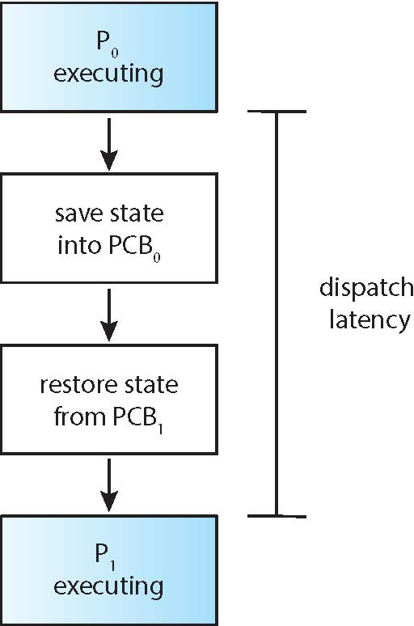
Dispatcher
Dispatcher module gives control of the CPU to the process selected by the CPU scheduler; this involves:
  switching context
  switching to user mode
  jumping to the proper location in the user program to restart that program
Dispatch latency – time it takes for the dispatcher to stop one process and start another running

Slide 13
Dispatch Latency
event
Response to event
Response interval
Process made
available
Real-time
Process
Execution
Interrupt
Processing
Dispatch latency
conflicts
dispatch
time

Slide 14
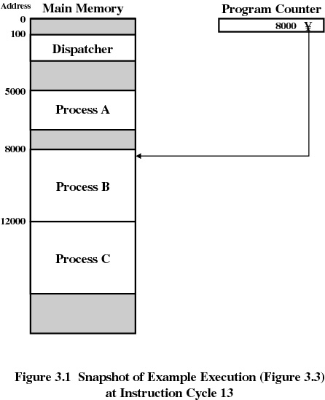
Example:
Concurrent Execution of Processes (1/3)

Slide 15
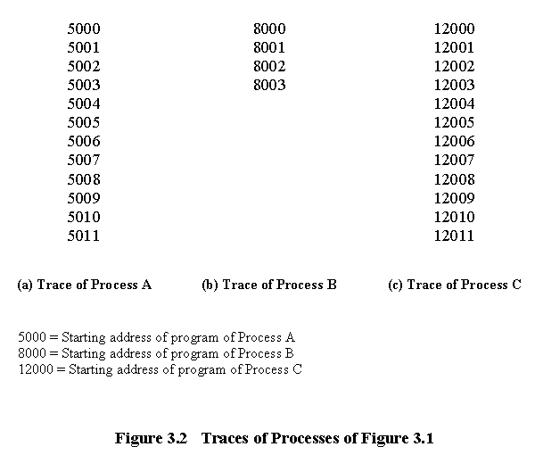
100
101
102
103
104
105
Dispatcher
100 = Starting address of dispatch program.

Slide 16
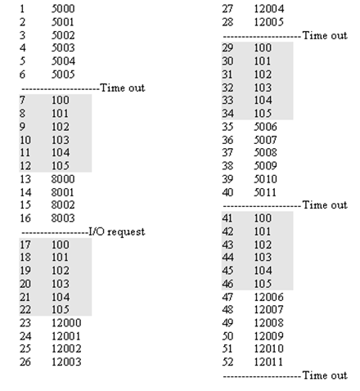
Notes:
CPU time or instruction cycle = 6 (each process)
Assume all processes execute in sequence with no priority
Shaded areas indicate execution of dispatcher process
1st & 3rd columns show number of instruction cycles
2nd & 4th columns shows address of instruction being executed
A
A
B
C
C

Slide 17

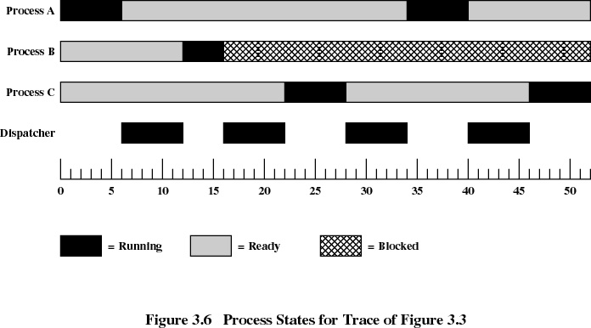
Concurrent Execution of Processes
(Process States)

Slide 18
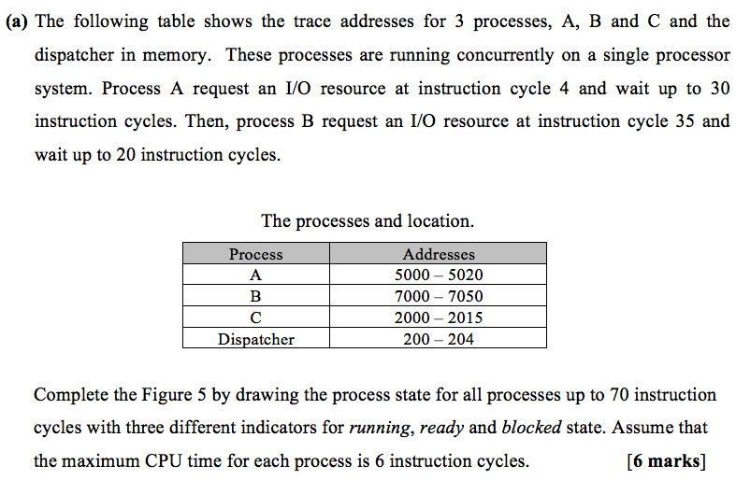

Slide 19
Process A
Process B
Process C
Dispatcher
Instruction Cycles
0 5 10 15 20 25 30 35 40 45 50 55 60 65 70
= Running
= Ready
= Blocked

Slide 20
Answer:
4
6
Process A
6
4
Process B
6
6
4
Process C
0 5 10 15 20 25 30 35 40 45 50 55 60 65 70
Dispatcher
= Running
= Ready
= Blocked

Slide 21
Answer:
4
6
Process A
6
4
Process B
6
6
4
Process C
Dispatcher
Instruction Cycles
0 5 10 15 20 25 30 35 40 45 50 55 60 65 70
= Running
= Ready
= Blocked

Slide 22
What is the process state for each process at x, y and z ? Justify your answer.
Exercise
x
y
z

Slide 23
5.2 Scheduling Criteria
CPU utilization – keep the CPU as busy as possible
Throughput – number of processes that complete their execution per time unit (e.g., 5 per second)
Turnaround time – amount of time to execute a particular process
Waiting time – total amount of time a process has been waiting in the ready queue
Response time – amount of time it takes from when a request was submitted until the first response is produced, not output (for time-sharing environment)

Slide 24
EXERCISE (DIY!!)
The table below shows the process’s location at memory for processes P, Q, R and Dispatcher. A single processor is used to run all processes. Process P request for I/O at instruction cycle 4 and wait up to 25 instruction cycles. Then, process R request for I/O at instruction cycle 23 and wait up to 24 instruction cycles. All processes run from 0 to 100 instruction cycles with three different indicators for running, ready and blocked state (unit in milliseconds). Assume that the maximum CPU burst for each process is 6 instruction cycles. Calculate the following questions [8m]:
Process | Addresses
P | 3000-3050
Q | 5000-5014
R | 2000-2020
Dispatcher | 200-205
What is the Turnaround Time of process Q? [2]
At time 26, what are the states for P, Q, and R? [2]
At time 43, what are the states for P, Q, and R? [2]
At what time does process R get the CPU after the blocked state? [2]
What is the Waiting Time of Process P? [2]

Slide 25
Optimization Criteria for Scheduling
Max CPU utilization
  Keep CPU busy 100% of time.
Max throughput
  Run as many jobs as possible in given amount of time.
Min turnaround time
  Move entire job in and out of system quickly.
Min waiting time
  Move job out of READY queue quickly.
Min response time
  Quickly turn around interactive requests.

Slide 26
5.3 Scheduling Algorithm
Based on specific policy
Allocate CPU and move job through system
Algorithm types
First –come, First-serve (FCFS)
Shortest-Job-First Scheduling (SJF)
Round-Robin Scheduling (RR)
Priority Scheduling
Multilevel Queue Scheduling
Current systems emphasize interactive use and response time (use preemptive policies)

Slide 27
First- Come, First-Served (FCFS) Scheduling
Non-preemptive
Job handled based on arrival time. Earlier job arrives, earlier served.
Consider the following three processes and their burst time.
Suppose that the processes arrive in the order: P₁ , P₂ , P₃
We use Gantt Chart to illustrate a particular schedule
Waiting time for P₁ = 0; P₂ = 24; P₃ = 27
Average waiting time: (0 + 24 + 27)/3 = 17
Process | Burst Time (ms)
P1 | 24
P2 | 3
P3 | 3
P1 | P2 | P3
0
24
27
30

Slide 28
FCFS Scheduling (Cont.)
Suppose that the processes arrive in the order:
P₂ , P₃ , P₁
The Gantt chart for the schedule is:
Waiting time for P₁ = 6; P₂ = 0; P₃ = 3
Average waiting time: (6 + 0 + 3)/3 = 3
Much better than previous case
Convoy effect - short process behind long process
  Consider one CPU-bound and many I/O-bound processes
P2 | P3 | P1
0
3
30

Slide 29
FCFS: Example 1
Three processes arrived in order Job A, Job B, Job C at time t₀ with different CPU burst. Calculate the average waiting time and average turn around time. Assume that FCFS algorithm applied.
Process | Burst Time
Job A | 15
Job B | 2
Job C | 1
Job
A
Job
B
Job
C
0 15 17 18
(Continued Next)

Slide 30
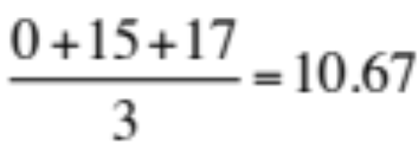
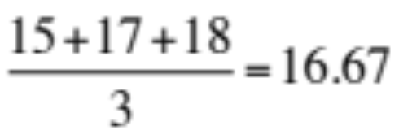
Job A
Job B
Job C
0 15 17 18
Solution:
Process | Burst Time
Job A | 15
Job B | 2
Job C | 1
Waiting Time
0
15
17
Turnaround Time
15 – 0 = 15
17 – 0 = 17
18 – 0 = 18
Average Waiting Time =
Average Turnaround Time =
Turnaround Time = Completion time – Arrival time
Waiting Time = Turnaround time time – Burst time

Slide 31
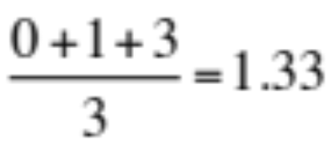
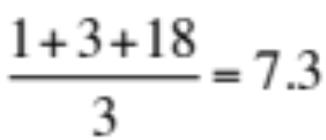
FCFS: Example 2
Three processes arrived in order Job C, Job B, Job A at time t₀ with different CPU burst time. Calculate the average waiting time and average turn around time. Assume that FCFS algorithm applied.
Process | CPU Burst Time
Job C | 1
Job B | 2
Job A | 15
Job
C
Job
B
Job
A
0 1 3 18
Average Waiting Time =
Average Turnaround Time =

Slide 32
Extra
Exercise 1:
Three processes Job A, Job B, Job C arrived at different time with the length of CPU burst given in milliseconds (ms). Calculate the average waiting time and average turn around time. Assume that FCFS algorithm applied.
Arrival Time | Process | CPU Burst
t₀ | Job A | 15
t₁ | Job B | 2
t₂ | Job C | 1
Turnaround Time = Completion time – Arrival time
Waiting Time = Turnaround time time – Burst time

Slide 33
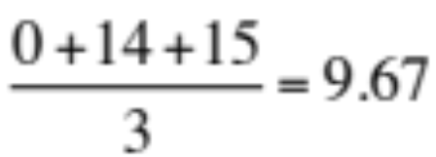
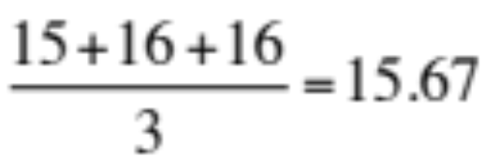
Solution 1 :
Job A
Job B
Job C
0 15 17 18
Arrival Time | Process | CPU Burst
t₀ | Job A | 15
t₁ | Job B | 2
t₂ | Job C | 1
Waiting Time
0
15 – 1 = 14
17 – 2 = 15
Turnaround Time
15 – 0 = 15
17 – 1 = 16
18 – 2 = 16
Average Waiting Time =
ms
Average Turnaround Time =
ms

Slide 34
FCFS:
Good for batch systems
Unacceptable in interactive systems
  Unpredictable waiting/turnaround time
Disadvantages
  Average waiting/turnaround time varies; seldom minimized
  Convoy effect whereby short processes queue behind long processes;
    Results in lower CPU and device utilization

Slide 35
Shortest-Job-First (SJF)/SJN
None pre-emptive
Also known as Shortest Job Next (SJN)
Associate with each process the length of its next CPU burst/cycle time
  Use these lengths to schedule the process with the shortest time
SJF is optimal – gives minimum average waiting time for a given set of processes
  How do we know what is the length of the next CPU request
  Could ask the user
    what if the user lies?

Slide 36
Example of SJF/SJN
Consider the following four processes and their burst time
Process | Burst Time (ms)
P1 | 6
P2 | 8
P3 | 7
P4 | 3
SJF scheduling chart
P4 | P1 | P3 | P2
0
3
9
16
24
Turnaround Time = Completion time – Arrival time
Waiting Time = Turnaround time time – Burst time

Slide 37
Solutions
P4 | P1 | P3 | P2
0
3
9
16
24
Process | Burst time (ms) | Turnaround time | Waiting Time
P1 | 6 | 9 – 0 = 9 | 9 – 6 = 3
P2 | 8 | 24 – 0 = 24 | 24 – 8 = 16
P3 | 7 | 16 – 0 = 16 | 16 – 7 = 9
P4 | 3 | 3 – 0 = 3 | 3 – 3 = 0
 |  | 52/4 = 13 | 28/4 = 7

Slide 38
SJF/SJN: Example 3
Four processes Job A, Job B, Job C and Job D arrived at time t₀ with different CPU burst. Calculate the average waiting time and average turn around time. Assume that SJN algorithm applied.
Process | CPU Burst
Job A | 5
Job B | 2
Job C | 6
Job D | 4

Slide 39
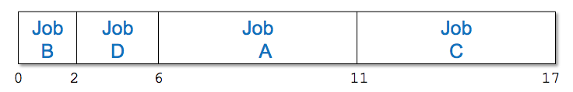
Solution:
Process | Burst Time
Job A | 5
Job B | 2
Job C | 6
Job D | 4
Waiting Time
6
0
11
2
Turnaround Time
11
2
17
6
Average Waiting Time :
= A + B + C + D = 6 + 0 + 11 + 2 = 4.75
4 4
Average turnaround time:
= A + B + C + D = 11 + 2 + 17 + 6 = 9.0
  4 4

Slide 40
Job
B
Job
D
Job
A
Job
C
0 2 6 11 17
We can see:
  Job B finishes in its given time, (2)
  Job D finishes in its given time plus the time waited for Job B to run, (4+2)
  Job A, time given plus B’s time, (5+4+2)
  Job C, time given plus A’s time, (6+ 5+4+2)

Slide 41

Waited time
(2) + (4 + 2) + (5 + 4 + 2) + (6 + 5 + 4 + 2) = 9.0
        4
As we can see:
  The time 1st job (B) appears 4 times; The 2nd job (D) appears 3 times ; The 3rd job (A) appears 2 times and the 4th job (C) appears only once (1).
Equation can be rewrite as:
(B)*4 + (D)*3 + (A)*2 + (C)*1 = 9.0
4
Formula for average:
t₁(n) + t₂(n-1) + t₃(n-2) + . . + t_{n}(n(1))
n
n = number of job in queue; t_{j} (j=1,2,3,…,n)

Slide 42
SJN / SJF:
Easy implementation in batch environment
  CPU time requirement known in advance
Does not work well in interactive systems
Optimal algorithm
  All jobs are available at same time.
  CPU estimation are available and more accurate.
If 2 processes have the same CPU bursts (cycle time), FCFS may be used.

Slide 43
Extra
Exercise 2:
Four processes Job A, Job B, Job C and Job D arrived at time t₀ with different CPU burst in milliseconds (ms). At t₂ , another processes Job X and Job Y arrived with its own CPU burst time. Calculate the average waiting time and average turnaround time. Assume that SJN algorithm applied and each t_{i} = i CPU Burst.
Arrival Time (t) | Process | CPU Burst
0 | Job A | 5
 | Job B | 2
 | Job C | 6
 | Job D | 4
2 | Job X | 3
 | Job Y | 1

Slide 44
Extra
Solution 2:
Job
B
Job
Y
Job
X
Job
D
Job
A
Job
C
0 2 3 6 10 15 21
A₅
B₂
C₆
D₄
A₅
C₆
D₄
X₃
Y₁
A₅
C₆
D₄
X₃
A₅
C₆
D₄
A₅
C₆
C₆
Processes in system to use CPU
Note: Job_{CPU}

Slide 45
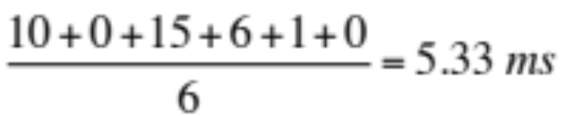
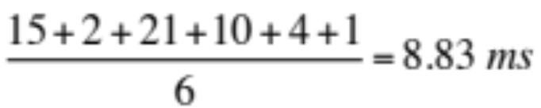
Extra
Job
B
Job
Y
Job
X
Job
D
Job
A
Job
C
0 2 3 6 10 15 21
Arrival Time | Process | CPU Burst
t₀ | Job A | 5
 | Job B | 2
 | Job C | 6
 | Job D | 4
t₂ | Job X | 3
 | Job Y | 1
Waiting Time
10
0
15
6
3 – 2 = 1
2 – 2 = 0
Turnaround Time
15
2
21
10
6 – 2 = 4
3 – 2 = 1
Average Waiting Time =
Average Turnaround Time =

Slide 46
Shortest-remaining-time-first (SRT/SRTF)
A preemptive version of SJF is called shortest-remaining-time-first
Processor allocated to job closest to completion.
  Preemptive if the newer job has shorter completion time.
Example illustrating the concepts of varying arrival times and preemption.
Average turnaround time = 51 /4 = 12.75 ms
Average waiting time = 6.25 ms
Process | Arrival Time (t) | CPU Burst | Turnaround | Waiting
P1 | 0 | 8 | 17 – 0 = 17 | 17 – 8 = 9
P2 | 1 | 4 | 5 – 1 = 4 | 4 – 4 = 0
P3 | 2 | 9 | 25 – 2 = 23 | 23 – 9 = 14
P4 | 3 | 5 | 10 – 3 = 7 | 7 – 5 = 2
P1
P2
P4
P1
P3
0 1 5 10 17 25

Slide 47
SRT : Example 4
Process | Burst Time | Arrival Time
Job A | 6 | t₀ = 0.0
Job B | 3 | t₁ = 1.0
Job C | 1 | t₂ = 2.0
Job D | 4 | t₃ = 3.0
Job
A
Job
B
Job
C
Job
B
Job
D
Job
A
0 1 2 3 5 9 14

Slide 48
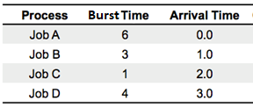
Here Job A is preempted by Job B because Job B has less CPU time remaining.
Here Job B is preempted by Job C because Job C has less CPU time remaining.
Now Job B can resume because Job C has finished.
Job D run next because it needs less CPU time to finish than does Job A.
Here Job A is finally allow to finish (resume).
Job
A
Job
B
Job
C
Job
B
Job
D
Job
A
0 1 2 3 5 9 14

Slide 49
Process | Burst Time | Arrival Time | Completion Time
Job A | 6 | 0.0 | 14
Job B | 3 | 1.0 | 5
Job C | 1 | 2.0 | 3
Job D | 4 | 3.0 | 9
Job
A
Job
B
Job
C
Job
B
Job
D
Job
A
0 1 2 3 5 9 14

Slide 50
Process | Burst Time | Arrival Time | Turnaround time | Waiting time
Job A | 6 | 0.0 | 14 – 0 = 14 | 14 – 6 = 8
Job B | 3 | 1.0 | 5 – 1 = 4 | 4 – 3 = 1
Job C | 1 | 2.0 | 3 – 2 = 1 | 1 – 1 = 0
Job D | 4 | 3.0 | 9 – 3 = 6 | 6 – 4 = 2
Job
A
Job
B
Job
C
Job
B
Job
D
Job
A
0 1 2 3 5 9 14
Average turnaround time = (14+4+1+6)/4 = 6.25 ms
Average waiting time = (8+1+0+2)/4 = 2.75 ms

Slide 51

Example 5 (Nonpreemptive SJN/SJF)
Job
A
Job
C
Job
B
Job
D
0 6 7 10 14
Process | CPU Burst | Arrival Time | Completion Time
Job A | 6 | 0.0 | 6
Job B | 3 | 1.0 | 10
Job C | 1 | 2.0 | 7
Job D | 4 | 3.0 | 14
Note: Job A initially in the READY queue so it runs first and
continues with the rest.
(Continued Next)

Slide 52
Job
A
Job
C
Job
B
Job
D
0 6 7 10 14
Process | CPU Burst | Time | Job in CPU | Job in READY queue
Job A | 6 | 0.0 | A | -
Job B | 3 | 1.0 | A | B
Job C | 1 | 2.0 | A | B, C
Job D | 4 | 3.0 | A | B, C, D
 |  | 6.0 | C | B, D
 |  | 7.0 | B | D
 |  | 10.0 | D | -
(Continued Next)

Slide 53
Job
A
Job
C
Job
B
Job
D
0 6 7 10 14
Turnaround time:
    Job : A B C D
    Turnaround : 6 9 5 11
Average turnaround time: 6 + 9 + 5 + 11 = 7.75
4
Comparison between example 4 and 5:
  SRT (6.25) is faster than SJN/SJF (7.75)
  → (0.12% faster)

Slide 54
SRT:
Often used in batch environments
  Short jobs given priority
Cannot implement in interactive system
  Requires advance CPU time knowledge
Involves more overhead than SJN/SJF
  System monitors CPU time for READY queue jobs
  Performs context switching

Slide 55
Round Robin (RR)
Preemptive. Used extensively in interactive systems.
Each process gets a small unit of CPU time (time quantum q). After this time has elapsed, the process is preempted and added to the end of the ready queue (FCFS).
Time quantum size
  Crucial to system performance
  Varies from 100 ms to 1-2 seconds
If there are N processes in the ready queue and the time quantum is q, then each process gets 1/N of the CPU time in chunks of at most q time units at once. No process waits more than (N-1)q time units.
Timer interrupts every quantum to schedule next process.

Slide 56
If job CPU burst > time quantum
  Job preempted and placed at end of READY queue
  Information saved in PCB
If job CPU burst < time quantum
  1) Job finished:
    allocated resources released and job returned to user
  2) Interrupted by I/O request:
    information saved in PCB and linked to I/O queue
    Once I/O request satisfied, Job returns to end of READY queue and awaits CPU
(Continued Next)

Slide 57

Efficiency
  Depends on time quantum size
    In relation to average CPU burst
Quantum too large (larger than most
CPU bursts)
  Algorithm reduces to FCFS scheme
Quantum too small
  Context switching occurs
    Job execution slows down
    Overhead dramatically increased

Slide 58
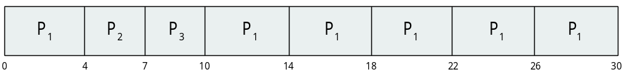
Example of RR with Time Quantum = 4
Consider the following three processes and their burst time
Process | Burst Time
P₁ | 24
P₂ | 3
P₃ | 3
The Gantt chart is:
The average waiting time under the RR policy is often longer.
Typically, higher average turnaround than SJF, but better response.
q should be large compared to context switch time.
q is usually 10ms to 100ms, context switch < 10 usec

Slide 59



RR : Example 6
Process | CPU Burst | Arrival Time
Job A | 8 | 0.0
Job B | 4 | 1.0
Job C | 9 | 2.0
Job D | 5 | 3.0
Time Slice =
4 milliseconds
(Continued Next)

Slide 60
Time:
0 1 2 3 4 5 6 7 8 12 16 20 24 25 26
A₈
A₇
B₄
A₆
B₄
C₉
A₅
B₄
C₉
D₅
A₄
B₄
C₉
D₅
A₄
C₉
D₅
A₄
C₅
D₅
A₄
C₅
D₁
C₅
D₁
C₁
D₁
C₁
Note: Job_{CPU}
Time Slice = 4 ms

Slide 61
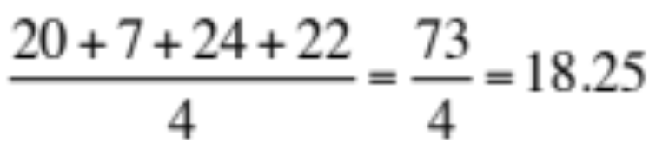
Process | CPU Burst | Arrival Time
Job A | 8 | 0.0
Job B | 4 | 1.0
Job C | 9 | 2.0
Job D | 5 | 3.0
Completion Time
20
8
26
25
TurnaroundTime
20 – 0 = 20
8 – 1 = 7
26 – 2 = 24
25 – 3 = 22
Average Turnaround Time =
(Continued Next)

Slide 62
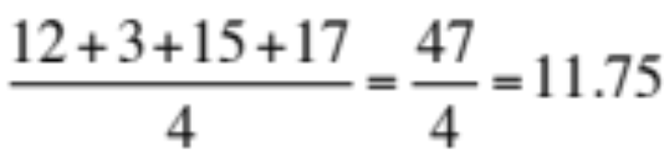
NEW
Process | CPU Burst | Arrival Time
Job A | 8 | 0.0
Job B | 4 | 1.0
Job C | 9 | 2.0
Job D | 5 | 3.0
Waiting Time
?
?
?
?
Waiting Time
(0 – 0) + (16 – 4) = 12
4 – 1 = 3
(8 – 2) + (20 – 12) + (25 – 24) = 15
(12 – 3) + (24 – 16) = 17
Average Waiting Time =

Slide 63
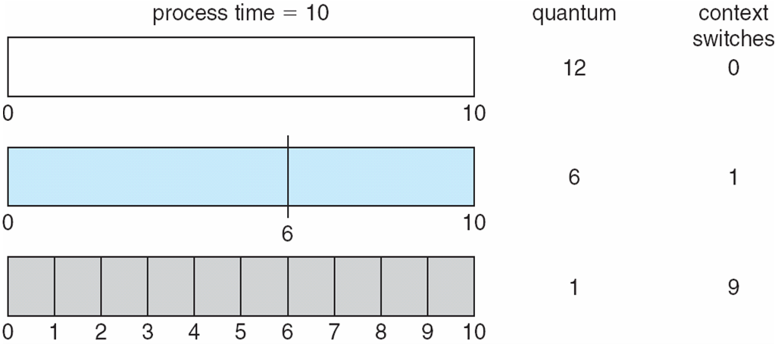
Time Quantum and Context Switch Time
The performance of the RR algorithm depends on the size of the time quantum. If the time quantum is extremely small (say, 1 millisecond), RR can result in a large number of context switches.

Slide 64
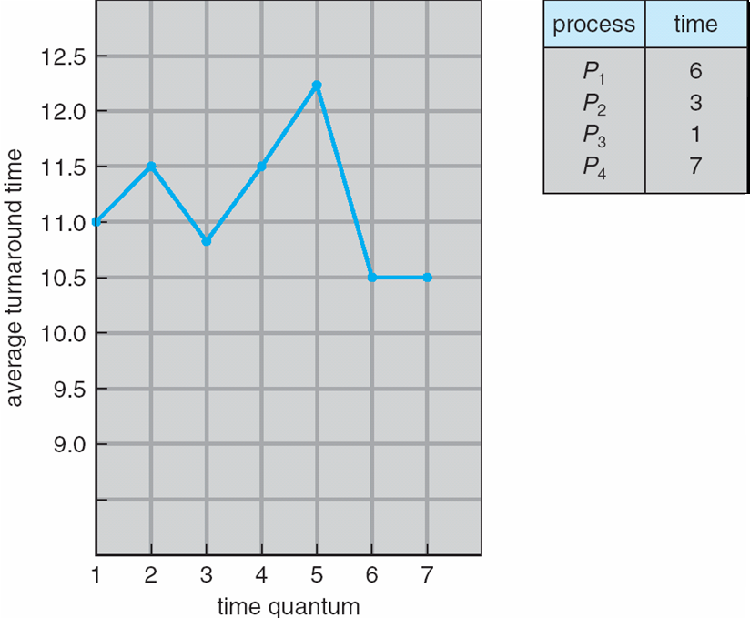
Turnaround Time Varies With The Time Quantum
The average turnaround time of a set of processes does not necessarily improve as the time-quantum size increases. In general, the average turnaround time can be improved if most processes finish their next CPU burst in a single time quantum.

Slide 65
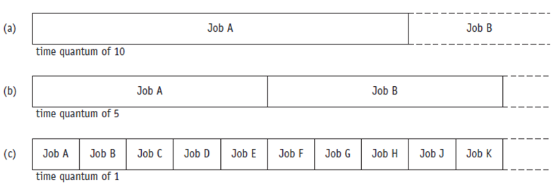
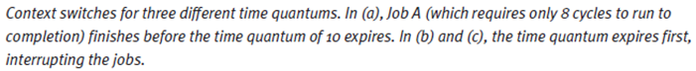
RR : Example 7

Slide 66
Case (a)
  There is no context switch
  Job A runs to completion since CPU burst end shortly before time quantum expires
  No different between RR and FCFS policies
Case (b)
  There is 1 context switch for the rest of Job A.
  Job A is preempted once when the time quantum expires
(Continued Next)

Slide 67
Case (c)
  There is 10 context switches for 2nd cycle of Job A.
  The job is preempted every time the time quantum expires
Weakness for case (b) & (c):
  Overhead become costly
  Turnaround time suffers
(Continued Next)

Slide 68
Priority Scheduling
A priority number (integer) is associated with each process.
The CPU is allocated to the process with the highest priority. (smallest integer ≡ highest priority)
  Preemptive
  Nonpreemptive
SJF is simply of priority scheduling where it uses the inverse of the next CPU burst time as its priority –
  The smaller the CPU burst, the higher the priority.
If two jobs having the same priority are READY, it works on a FIRST COME, FIRST SERVED basis.
Problem ≡ Starvation – low priority processes may never execute.
Solution ≡ Aging – as time progresses increase the priority of the process.

Slide 69
Example of Priority Scheduling
Consider the following five processes and their burst time
Process | CPU Burst | Priority | Turnaround time | Waiting time
P1 | 10 | 3 | 16 – 0 = 16 | 16 – 10 = 6
P2 | 1 | 1 | 1 – 0 = 1 | 1 – 1 = 0
P3 | 2 | 4 | 18 – 0 = 18 | 18 – 2 = 16
P4 | 1 | 5 | 19 – 0 = 19 | 19 – 1 = 18
P5 | 5 | 2 | 6 – 0 = 6 | 6 – 5 = 1
Priority scheduling Gantt Chart
Average waiting time = 8.2 msec
P2
P5
P1
P3
P4
0 1 6 16 18 19

Slide 70
System Administrator or Processor Manager use different methods of assigning priorities.
Processor Manager priority assignment methods:
  Memory requirements
    Jobs requiring large amounts of memory
    Allocated lower priorities (vice versa)
  Number and type of peripheral devices
    Jobs requiring many peripheral devices
    Allocated lower priorities (vice versa)
  Total CPU time
    Jobs having a long CPU burst
    Given lower priorities (vice versa)
  Amount of time already spent in the system (aging)
    Total time elapsed since job accepted for processing
    Increase priority if job in system unusually long time

Slide 71
Extra
Exercise 3:
Five processes Job A, Job B, Job C, Job D and Job E arrived at time t₀ with different CPU burst and priority level. Calculate the average waiting time and average turnaround time. Assume the following scheduling algorithm applied separately.
a) FCFS, SJN and Priority
b) Which one is the best in term of average waiting time and
turnaround time? Why?
Process | CPU Burst | Priority
Job A | 10 | 3
Job B | 1 | 1
Job C | 2 | 4
Job D | 1 | 5
Job E | 5 | 2

Slide 72
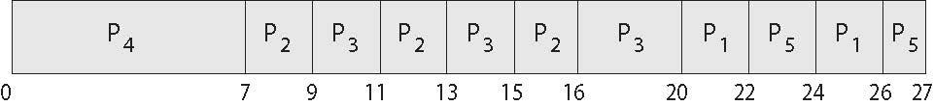
Combining Priority Scheduling and RR
System executes the highest priority process; processes with the same priority will be run using round-robin (q = 2).
Consider the following five processes and their burst time
identify the priority
if 2 processes has same priority, apply FCFS
Process | Burst Time | Priority
P₁ | 4 | 3
P₂ | 5 | 2
P₃ | 8 | 2
P₄ | 7 | 1
P₅ | 3 | 3
Priority scheduling Gantt Chart
Average waiting time = 13.6 ms ( previously 8.2 ms)
25

Slide 73
Combining Priority Scheduling and RR
25
Process | Burst Time | Priority | Completion time | Turnaround time | Waiting time
P₁ | 4 | 3 | 25 | 25 – 0 = 25 | 25 – 4 = 21
P₂ | 5 | 2 | 16 | 16 – 0 = 16 | 16 – 5 = 11
P₃ | 8 | 2 | 20 | 20 – 0 = 20 | 20 – 8 = 12
P₄ | 7 | 1 | 7 | 7 – 0 = 7 | 7 – 7 = 0
P₅ | 3 | 3 | 27 | 27 – 0 = 27 | 27 – 3 = 24
Average waiting time = 13.6 ms
Average turnaround time = 19 ms
Turnaround Time = Completion time – Arrival time
Waiting Time = Turnaround time time – Burst time

Slide 74
Multilevel Queue
Hybrid environment. Ready queue is partitioned into separate queues, eg:
  foreground (interactive)
  background (batch)
Process permanently in a given queue
Each queue has its own scheduling algorithm:
  foreground – RR
  background – FCFS
Scheduling must be done between the queues:
  Fixed priority scheduling; (i.e., serve all from foreground then from background). Possibility of starvation.
  Time slice – each queue gets a certain amount of CPU time which it can schedule amongst its processes;
  i.e., 80% to foreground in RR, 20% to background in FCFS

Slide 75
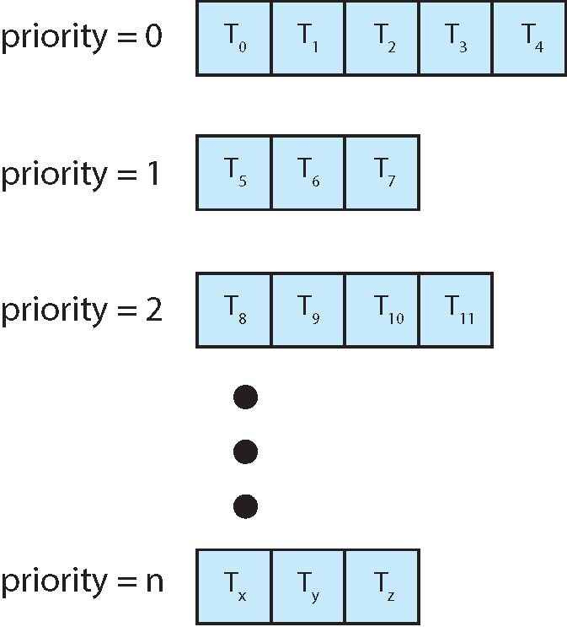
Separate Queue For Each Priority
Works in conjunction with several other schemes
Works well in systems with jobs grouped by common characteristics.

Slide 76
Four primary methods:
  Not allowing movement between queues
  Movement jobs between queues
  Variable Time Quantum Per Queue
  Aging- giving special treatment to jobs that have been in the system for a long time
(Continued Next)

Slide 77
Case 1: No Movement Between Queues
Simple
Rewards high-priority jobs
  Processor allocated using FCFS
Processor allocated to lower-priority jobs
  Only when high-priority queues empty
Good environment
  Few high-priority jobs
  Spend more time with low-priority jobs

Slide 78
Case 1: No Movement Between Queues
(FCFS)
CPU
Q1
(High Priority)
Q2
(Low Priority
J2
J4
J1
J5
J3
Arrival of jobs: J1, J2, J3, J4, J5

Slide 79
Case 1: No Movement Between Queues
(FCFS)
CPU
Q1
(High Priority)
J3
J2
Q2
(Low Priority
J5
J4
J1

Slide 80
Case 2: Movement Between Queues
Processor adjusts priorities assigned to each job
High-priority jobs
  Initial priority favorable
    Treated like all other jobs afterwards
Quantum interrupt
  Job preempted
    Moved to next lower queue
    May have priority increased
Good environment
  Jobs handled by cycle characteristics (CPU or I/O)
  Interactive systems

Slide 81
Case 2: Movement Between Queues
(Time Quantum = 5)
CPU
Q1
(High Priority)
Q2
(Low Priority
Job | CPU Burst
1 | 5
2 | 10
3 | 4
4 | 2
5 | 3
J2
J4
J1
J5
J3
Arrival of jobs: J1, J2, J3, J4, J5

Slide 82
Case 2: Movement Between Queues
(Time Quantum = 5)
CPU
Q1
(High Priority)
J3
J2
Q2
(Low Priority
J2
J2
J2
J2
J5
J4
J1
Job | CPU Burst
1 | 5
2 | 10
3 | 4
4 | 2
5 | 3
5

Slide 83
Case 3: Variable Time Quantum Per Queue
Is a variation of the movement between queues
Each queue given time quantum size
  Size twice as long as previous queue
Fast turnaround for CPU-bound jobs
CPU-bound jobs execute longer and given longer time periods
  Improves chance of finishing faster
I/O-bound jobs (such as printing a series of documents) have many brief CPU bursts and long I/O cycles,
CPU-bound jobs (such as finding the first 300 prime numbers) have long CPU bursts and shorter I/O cycles.
83

Slide 84
Case 3: Variable Time Quantum Per Queue
(Time Quantum = 5)
CPU
Q1
(High Priority)
J3
J2
(Time Quantum = 10)
Q2
(Low Priority)
J2
J2
J2
J2
J5
J4
J1
Job | CPU Burst
1 | 9
2 | 15
3 | 4
4 | 2
5 | 3
10

Slide 85
Case 4: Aging
Ensures lower-level queue jobs eventually complete execution
System keeps track of job wait time
If too “old”
  System moves job to next highest queue
  Continues until old job reaches top queue
  May drastically move old job to highest queue
Advantage
  Guards against indefinite unwieldy job postponement

Slide 86
Case 4: Aging
(FCFS)
CPU
Q1
(High Priority)
Q2
(Low Priority
Job | CPU Burst
1 | 9
2 | 100
3 | 30
4 | 20
5 | 5
J1
J2
Arrival of jobs at t0: J1, J2

Slide 87
Case 4: Aging
(FCFS)
CPU
Q1
(High Priority)
J2
Q2
(Low Priority
J1
Job | CPU Burst
1 | 9
2 | 100
3 | 30
4 | 20
5 | 5
Job 2 is running

Slide 88
Case 4: Aging
(FCFS)
CPU
Q1
(High Priority)
J2
Q2
(Low Priority
J1
Job | CPU Burst
1 | 9
2 | 100
3 | 30
4 | 20
5 | 5
J3
J4
t50 → Next new jobs arrived: J3, J4 (low priority), J2 still running

Slide 89
Case 4: Aging
(FCFS)
CPU
Q1
(High Priority)
J2
Q2
(Low Priority
J4
J3
J1
Job | CPU Burst
1 | 9
2 | 100
3 | 30
4 | 20
5 | 5
J5
t70 → Next new jobs arrived: J5 (High priority),
J2 still running, J1 has been waiting 70 CPU burst time

Slide 90
Case 4: Aging
(FCFS)
CPU
Q1
(High Priority)
J5
J1
J2
Q2
(Low Priority
J4
J3
Job | CPU Burst
1 | 9
2 | 100
3 | 30
4 | 20
5 | 5
t100 → J2 , completed. J5 then running.
Continued with low priority jobs.

Slide 91
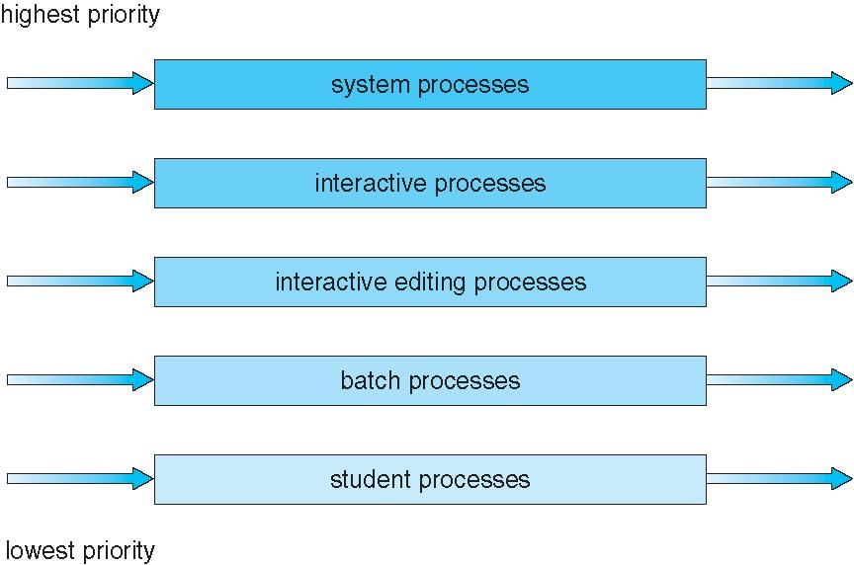
Multilevel Queue Scheduling

Slide 92
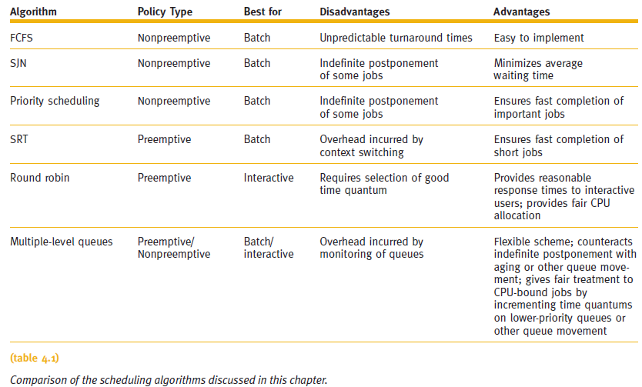
Summary (cont'd.)
#SJF
#can be preemptive also

Slide 93
Multilevel Feedback Queue
A process can move between the various queues; aging can be implemented this way.
The idea is to separate process according to the characteristics of their CPU bursts.
Multilevel-feedback-queue scheduler defined by the following parameters:
  number of queues
  scheduling algorithms for each queue
  method used to determine when to upgrade a process
  method used to determine when to demote a process
  method used to determine which queue a process will enter when that process needs service

Slide 94

Example of Multilevel Feedback Queue
Three queues:
  Q₀ – RR with time quantum 8 milliseconds
  Q₁ – RR time quantum 16 milliseconds
  Q₂ – FCFS
Scheduling
  A new job enters queue Q₀ which is served FCFS
    When it gains CPU, job receives 8 milliseconds
    If it does not finish in 8 milliseconds, job is moved to queue Q₁
  At Q₁ job is again served FCFS and receives 16 additional milliseconds
    If it still does not complete, it is preempted and moved to queue Q₂
  Processes in queue Q₂ are run on an FCFS basis but are run only when queues Q₀ and Q₁ are empty.
  This scheduling algorithm gives highest priority to any process with a CPU burst of 8 ms or less.

Slide 95
Extra
MFQ: Exercise 9
Five processes Job A, Job B, Job C, Job D and Job E arrived at time t₀ with different CPU burst and priority level. Assume that MFQ Scheduling algorithm is applied with 2 levels and the priority range 1 Highest. By given an initial time quantum for the first level is 5 CPU bursts and the last level using FCFS, calculate the average waiting time and average turnaround time.
Process | CPU Burst | Priority
Job A | 10 | 3
Job B | 1 | 1
Job C | 2 | 4
Job D | 1 | 5
Job E | 5 | 2

Slide 96
NEW
Process | CPU Burst | Priority
Job A | 10 | 3
Job B | 1 | 1
Job C | 2 | 4
Job D | 1 | 5
Job E | 5 | 2
5
0
0
0
0
0
₅
₄
₃
₂
₁
Job D
Job C
Job A
Job E
Job B
CPU
Q0
J_{B}
J_{E}
J_{A}
J_{C}
J_{D}
time quantum = 5
0
1
6
11
13
14
Q1
J_{A}
FCFS
14
19

Slide 97
Process | CPU Burst | Priority
Job A | 10 | 3
Job B | 1 | 1
Job C | 2 | 4
Job D | 1 | 5
Job E | 5 | 2
Completion
19
1
13
14
6
Turnaround time
19 – 0 = 19
1 – 0 = 1
13 – 0 = 13
14 - 0 = 14
6 – 0 = 6
Waiting time
(6 – 0)+(14 – 11) = 10
0 - 0 = 0
11 – 0 = 11
13 – 0 = 13
1 - 0 = 1
Q0
J_{B}
J_{E}
J_{A}
J_{C}
J_{D}
time quantum = 5
0
1
6
11
13
14
Q1
J_{A}
FCFS
14
19
Average Turnaround Time = (20 + 1 + 13 + 1 4+ 6)/5 = 10.6 ms
Average Waiting Time = (10 + 0 + 11 + 13 + 1)/5 = 7 ms

Slide 98
EXERCISE (DIY!!)
The table below shows five jobs A, B, C, D and E arrived at different times and with different CPU bursts. The Multilevel Feedback Queue (MFQ) scheduling is used with three queues (Qi). Given an initial time, the quantum for the Q₀ is 5, Q₁ is 10 and the last queue uses FCFS. Calculate the following questions [12m]:
Jobs | Arrival Time | CPU Burst
A | 0 | 15
B | 4 | 35
C | 26 | 4
D | 28 | 24
E | 32 | 33
What is the maximum value of CPU burst time that the jobs get at the Q1 level? [2]
Which job(es) will finish at level Q1? [2]
At the Q1 level, what is the second job that gets the CPU, and at what time does it occur? [2]
What is the Waiting Time of Process B? [2]
What is the Average Turnaround time? [2]
What is the Average Waiting time? [2]

Slide 99
Summary
Processor Manager allocates CPU among all users
Job Scheduler
  Assigns job to READY queue
    Based on characteristics
Process Scheduler
  Instant-by-instant allocation of CPU
Scheduling algorithm is unique
  Characteristics, objectives, and applications
System designer selects best policy and algorithm
  After careful strengths and weaknesses evaluation

Slide 100
End of Chapter 5

